Slide 1
Entrepreneurship Key Competence for Lifelong Learning
Mini-lesson

Slide 2
In this presentation…
What is a key competence
Key Competences for Lifelong Learning – A European Reference Framework
Entrepreneurship key competence
EntreComp
Competence Oriented Approach
Being na entrepreneurial teacher
6 guiding principles for developing students’ entrepreneurial competences

Slide 3
What is a key competence?
The key competences are a combination of knowledge, skills and attitudes.
Knowledge - Knowledge is composed of the concepts, facts and figures, ideas and theories which are already established, and support the understanding of a certain area or subject.
Skills - Skills are defined as the ability to carry out processes and use the existing knowledge to achieve results.
Attitudes - Attitudes describe the disposition and mindset to act or react to ideas, persons or situations.

Slide 4
Background
2006
The European Parliament and the Council of the European Union adopted a Recommendation on key competences for lifelong learning.
Member States were asked to develop the provision of key competences for all as part of their lifelong learning strategies and use the “Key Competences for Lifelong Learning – A European Reference Framework”.

Slide 5
Background
OECD surveys on educational programmes indicated a constant high share of teenagers and adults with insuficiente basic skills.
1 in 5 pupils had seriuos difficulties in developing sufificient Reading, mathematic or science skills. (PISA results 2015)
2015
44% of the EU population have low or no (19%) digital skills (EC Digital Scoreboard 2017)
Notes:
OECD – Organisation for Economic Cooperation and Development
5

Slide 6
Background
The New Skills Agenda for Europe (EC, 2016) announced the review of the 2006 Recommendation ackowledging that investing in skills and competences and in a shared and updated understanding of key competences is a first step for fostering education and training in Europe.

Slide 7
Entrepreneurship

Slide 8
What is Entrepreneurship key competence?
Capacity to act upon opportunities and ideas, and to transform them into values (social, cultural, or financial) for others. It is founded upon creativity, critical thinking and problem solving, taking initiative and perseverance and the ability to work collaboratively in order to plan and manage projects.

Slide 9
EntreComp: Entrepreneurship Competence Framework
Created as a reference tool to help improve the entrepreneurial capacity of European people and organisations.
Aims to build consensus around a common understanding of entrepreneurship competence.
https://audiovisual.ec.europa.eu/en/video/I-163141?&lg=OR

Slide 10
What is Entrepreneurship key competence?
Knowledge
Different contexts and opportunities for turning ideas into action in personal, social and professional activities, and an understanding of how these arise.
Approaches to planning and management of projects, which include both processes and resources.
Economics and the social and economic opportunities and challenges facing an employer, organisation or society.
Ethical principles and challenges of sustainable development
Self-awareness of own strengths and weaknesses.

Slide 11
What is Entrepreneurship key competence?
Skills
founded on creativity which includes imagination, strategic thinking and problem-solving, and critical and constructive reflection within evolving creative processes and innovation.
include the ability to work both as an individual and collaboratively in teams, to mobilize resources (people and things) and to sustain activity. This includes the ability to make financial decisions relating to cost and value.
essential - the ability to effectively communicate and negotiate with others, and to cope with uncertainty, ambiguity and risk as part of making informed decisions.

Slide 12
What is Entrepreneurship key competence?
Attitudes
Sense of initiative and agency, pro-activity, being forward-looking, courage and perseverance in achieving objectives.
A desire to motivate others and value their ideas, empathy and accepting responsibility.
Taking ethical approaches throughout the process.

Slide 13
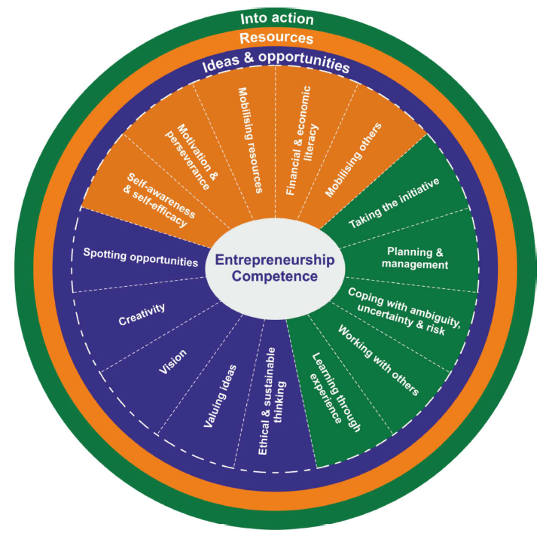
EntreComp: Entrepreneurship Competence Framework
3 interrelated and interconnected competence areas, each made of 5 competences.
15 competences, learning outcomes and proficiency levels – 442 learning outcomes.
“Learners have different starting points for their skills development and the different priorities of a learning activity; so learning outcomes from across different levels of the progression model may be relevant for the same learning activity.”
Andy Penaluna, University of Wales
Notes:
Give EntreComp factsheet
13

Slide 14
EntreComp: Entrepreneurship Competence Framework
Emphasis in the definition of entrepreneurship competence remains on the broad understanding of turning ideas into action and creating value, both as something that happens over time and that involves people and things (resources).
Social, commercial and cultural processes and outcomes refer to activity that makes a positive contribution to individuals' lives and to the sustainable development of society as a whole. This contribution is also reflected in the skill of 'negotiating with others with empathy’.
‘Creativity' and 'innovation' are sometimes thought of as discrete skills (alongside risk-taking) within entrepreneurship competence, being more accurately understood as processes that entrepreneurship skills play a part in.

Slide 15
Top tips for getting started with EntreComp
UNDERSTAND THE STARTING POINT OF YOUR LEARNERS
Whoever they are, employees or school children, they will have different starting points for their skills development. A learner is not expected to develop all the competences to a specific level.
REFINE OR EVALUATE LEARNING STRATEGIES
Consider how you could adapt your approach or introduce opportunities for practical entrepreneurial experiences to also develop one or more entrepreneurship competences.

Slide 16
Competence Oriented Approach

Slide 17
Competence oriented approach
Teaching and learning approach that aims at developing key competences.
It is best explained if compared with knowledge-based teaching and learning, which focuses on the knowledge aspect only.
Three challenges were identified:
the use of a variety of learning approaches and contexts;
support to educational staff;
assessment and validation of competence development.
Notes:
Competence oriented education refers to a teaching and learning approach that aims at developing key competences including relevant knowledge, skills and attitudes. It is best explained if compared with knowledge-based teaching and learning, which focuses on the knowledge aspect only.
17

Slide 18
Competence oriented approach
Moving to a competence-oriented approach in education, training and learning represents a paradigm shift.
It impacts not only on the structure of curricula, but also changes the organisation of learning. Often requires…
cross-curricular approaches
greater emphasis on interactive learning and teaching styles
combining formal with non-formal and informal learning
more collaboration with non-education stakeholders and local community
new role of the teacher, trainer and educator in guiding learning processes
new approaches to assessment.
Notes:
Competence oriented education refers to a teaching and learning approach that aims at developing key competences including relevant knowledge, skills and attitudes. It is best explained if compared with knowledge-based teaching and learning, which focuses on the knowledge aspect only.
18

Slide 19
Competence oriented approach
Digital technologies used in project-based learning, for example, improve the studying process and support the development of digital competences.
Competence Oriented Approach
Project based
Inquiry based
Arts based
Experiential or work-based
offers opportunities for innovation, collaboration and cross-discipline learning;
puts learners at the centre and asks for their active participation.
Notes:
Competence oriented approaches such as project based, arts based, inquiry based, experiential or work-based learning, improve learning outcomes and learner engagement. At the same time, they offer opportunities for innovation, collaboration and cross-discipline learning; they put learners at the centre and ask for their active participation. Digital technologies used in project-based learning, for example, improve the studying process and support the development of digital competences. When combined with social and emotional learning and health-enhancing physical activities, competence-oriented approaches increase the overall learners’ motivation, performance and active participation.
19

Slide 20
Competence oriented approach
Variety of learning environments
Notes:
It is best supported when taking place in a variety of learning environments.
For example, cooperation with stakeholders in the arts and conducting learning in a museum can prove beneficial for cultural awareness and expression development.
20

Slide 21
Competence oriented approach
Employers
Cross-sectoral cooperation eases the transition from education to work, and from work to education, and establishes a firm link between what is being taught and societal change and relevance.
Education
Local communities
Opportunities for entrepreneurial experiences, traineeships in companies or having entrepreneurs visit education and training institutions are beneficial for both young people and adults.
Notes:
Collaboration among education, training and non-formal learning stakeholders and cooperation with non-educational partners in local communities and employers support it.
21

Slide 22
Being an entrepreneurial teacher

Slide 23
Entrepreneurial teacher
Inspirational
Rule breaker
Supports the individual learning process of students
Prefers project-based learning
COACH
Focusing on real-life experiences
flexible
CONFIDENT
Team-player
Open-minded
Seeks to close the gap between education & economy
Responsible
Includes external experts in their teaching
Good listener
Passion for teaching

Slide 24
Entrepreneurial educators
develop an entrepreneurial approach to teaching and learning, they create an environment that enables innovation in teacher education and teaching practice.
reward individual initiative, responsibility taking and risk taking. Are ready to accept failure as an integral part of a learning process.
need to learn how to manage risks. Failure is an integral part of the entrepreneurial process but it can also be a costly waste of time, skill and commitment. Entrepreneurial teachers know how to mitigate risks.
have strong team working skills and are networkers. They exchange with their peers and meet up regularly.
use a variety of creative methods as innovative pedagogical tools and let trainees take responsibility of their own learning process.
in their assessment methods, acknowledge not only the solution, but also the process of how to get there.
use technology and digital media in the classroom to support learning. They explore new solutions, production techniques and computing tools which support the learning process.
collect student feedback systematically since they know that learners’ enthusiasm is an important driver for the implementation of entrepreneurship education.

Slide 25
EXPERIENTIAL LEARNING
Concrete Experience (doing/having and experience)
Reflective Observation (reviewing/reflecting on the experience)
Abstract Conceptualism (concluding /learning from the experience)
Active Experimentation
(planing / trying out what was learned)
Teachers do not necessarily provide students with the answers, but help them to research and identify right questions and find the best answers.
Experiential learning "the process whereby knowledge is created through the transformation of experience. Knowledge results from the combinations of grasping and transforming the experience.“
The experiential theory proposed by Kolb takes a more holistic approach and emphasizes how experiences, including cognition, environmental factors, and emotions, influence the learning process.
Kolb theory
Notes:
25

Slide 26
6 guiding principles for developing students entrepreneurial competences

Slide 27
1- Facilitate creative thinking throughout the learning process
6 guiding principles
Helping trainees explore and evaluate multiples ideas to create value. Encouraging trainees to wonder about possibilities and be adaptable to different ideas and solutions. Allow them to test out ideas, make comparisons and to continually reflect on (and adapt) the usefulness of their proposed solutions to problems. The generation of ideas that have value to oneself and then others is at the core of what it means to be entrepreneurial, creativity is a driving force behind these ideas and how they are designed and implemented.
This Photo by Unknown Author is licensed under CC BY-SA
Notes:
6 guiding principles for developing students entrepreneurial competences

Slide 28
2- Promote active entrepreneurial learning through real-world contexts
6 guiding principles
Active learning occurs when students are engaged in authentic activities which stimulate creative thinking.
Entrepreneurial learning is best promoted when students have regular opportunities to interact with the world outside the classroom. This includes engaging with real-world problems and issues within the community and further afield. This goes towards activities such as community projects planned, developed and evaluated by students in collaboration with others.
The trigger points for such a project might include a simple question that trainees ask about their community, an observation about their environment, a topical news story, a project/problem-based scenario presented by the trainer which as no clear answer, or an evolving problem as investigation unfolds.
This Photo by Unknown Author is licensed under CC BY-NC

Slide 29
3 - Foster purposeful collaboration both in and beyond the school
6 guiding principles
As a life skill, trainees need to learn how to get on with other people. They need to develop social and emotional competence so that they fit into the workplace, establish lasting relationships, and share interest with others.
The Education Endowment Foundation (EEF, 2018)* defines collaborative learning as an “approach which involves pupils working together on activities and learning tasks in small enough groups that everyone is able to participate in the assigned collective task. Pupils may work on separate tasks contributing to an overall outcome or work together on a shared task.”
The most impactful learning occurs when tasks are well-designed and there is time to talk and interact.
This Photo by Unknown Author is licensed under CC BY-NC
*EEF (2018) Teaching and Learning Toolkit – http://www.collaborativelearning.org/
This Photo by Unknown Author is licensed under CC BY-NC
Notes:
If you want to go fast, go alone. If you want to go far, go together.

Slide 30
4 - Encourage students to create value for others through their learning
6 guiding principles
Value creating pedagogy is when trainers support their trainees learning by applying their competences to create something of value to at least one external stakeholder. This could be a stakeholder outside their own group, class, or school. The value that the trainee creates for someone else can be economic, social or cultural.
The purpose from the educator’s perspective of this set-up is deeper learning, and the means is by empowering them to create value for others. This approach can impact on learner engagement, as learners become more motivated by creating value for someone else.
This Photo by Unknown Author is licensed under CC BY-SA

Slide 31
5 - Stimulates reflexion, flexible thinking and learning from experience
6 guiding principles
Reflexive practice has been widely endorsed as an important mean of supporting teachers’ professional development. One of the goals is to increase awareness about one’s own teaching and effectiveness from different viewpoints.
This means teachers need to be open-minded and think flexibly in the way they approach their planning, teaching, and assessment. At times, they may plan lessons along the path of prescribed learning objectives but on other occasions plan in a more open manner in which trainees set their own goals they hope to achieve in a project.
This calls for a willingness to learn from experience, to embrace mistakes as part of such learning and take risks in teaching and learning. By modelling and allowing trainees to practice these behaviours, trainers encourage the development of entrepreneurial competences.
This Photo by Unknown Author is licensed under CC BY-NC-ND

Slide 32
6 - Makes entrepreneurial competences an explicit part of learning and assessment
6 guiding principles
To improve the quality of entrepreneurial learning we need to make explicit what is expected of trainees. In lessons, this means ensuring that they are clear about the entrepreneurial learning objectives and criteria to achieve these. It calls for teachers to align their assessment with the objectives and ensuring that trainees have sufficient opportunities to learn and demonstrate entrepreneurial competence. Teaching and feedback provided needs to focus explicitly on entrepreneurial competences and revolve around how well trainees collaborate and turn their ideas into action.
This Photo by Unknown Author is licensed under CC BY

Slide 33
Active methods of engaging learners
PROJECT BASED LEARNING
ACTIVE LEARNING
INDEPENDENT LEARNING
REAL-LIFE SITUATIONS
CHALLENGE BASED LEARNING
Notes:
project-based, active learning or independent learning
These can be piloted in specific programmes; emerging good practices should be shared amongst teacher educators to eventually become embedded in day-to-day pedagogy. Non-traditional learning environments (real-life situations, out of classroom) should be available for all students.
Make room for experimentation. New teaching methods and innovative projects are given space and support to succeed. Educators are allowed an experimental attitude acknowledging that sometimes things will fail.

